Slide 1
IoT on AWS
Deep Learning & Autonomous Cars
Leverage AWS Now
LAN2018 Meetup
AI@Philadelphia

Slide 2
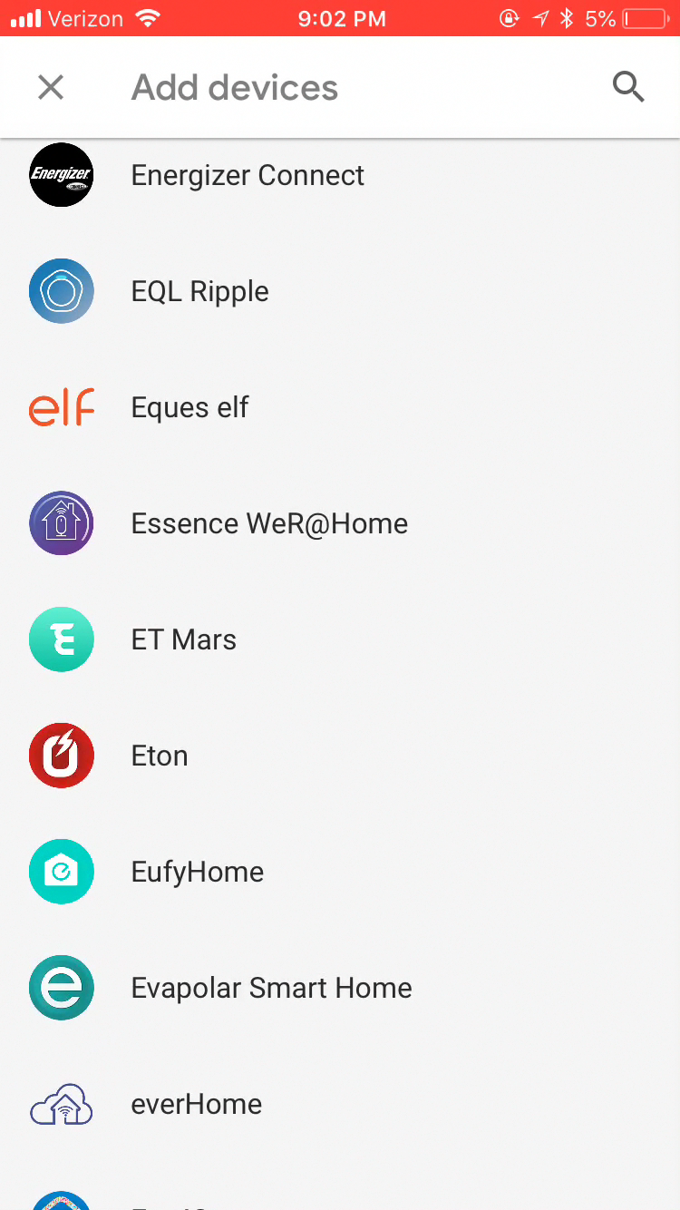
Why IoT Now?
Notes:
Adding Live Data

Slide 3
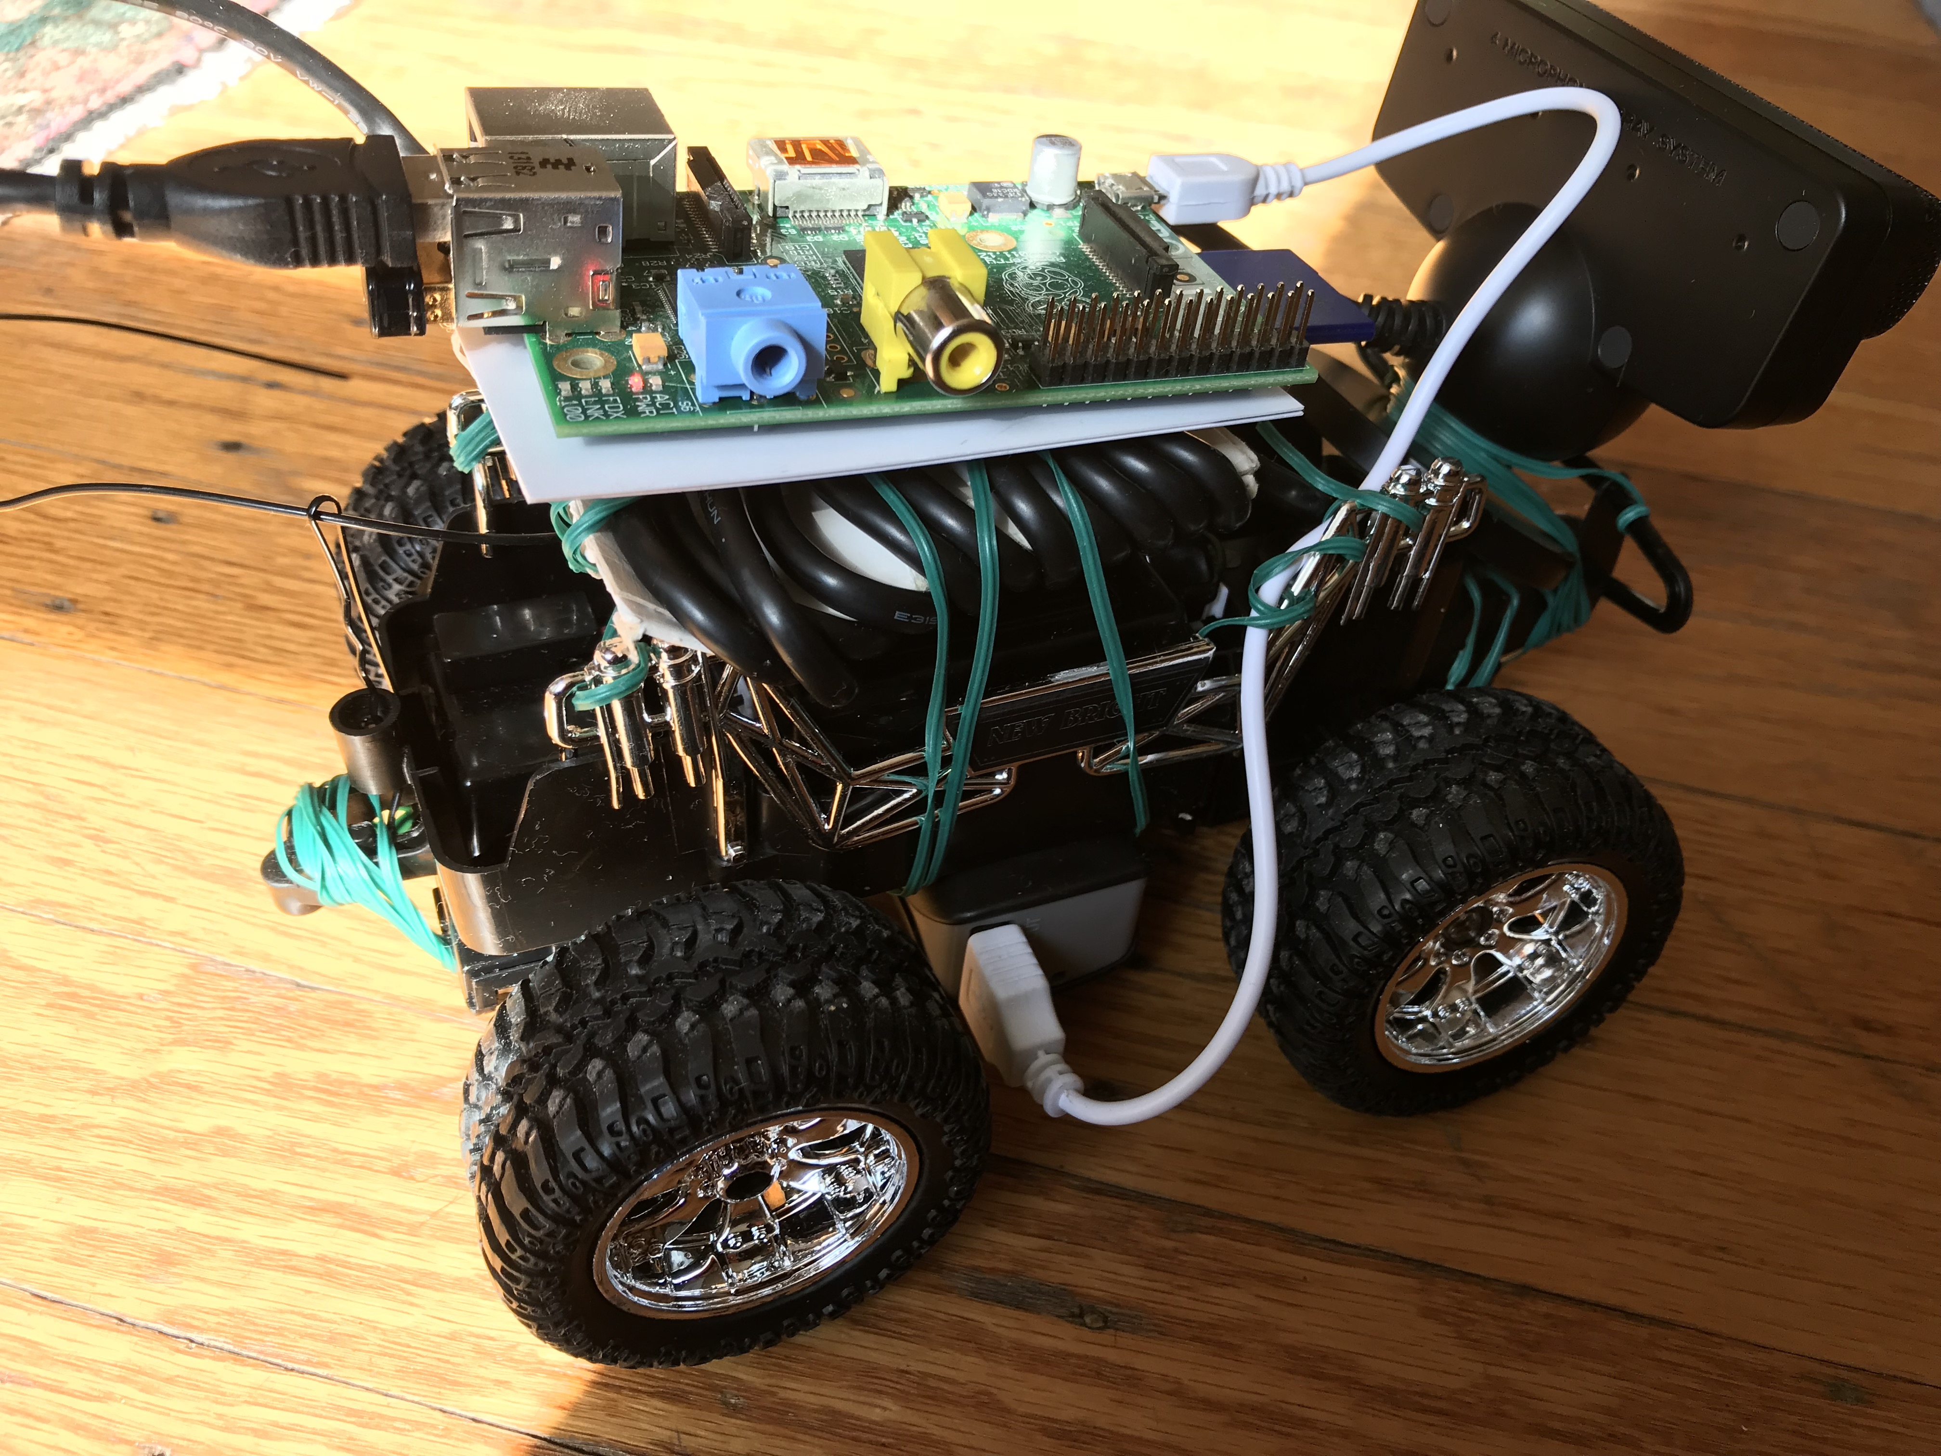
A Platform vs. A Hack
W
W is for Wireless LAN.
Motion Off: 3 hours and 20 minutes
Motion: 2 hours and 10 minutes
Utility
Affordability (BOM <$80)
Documentation
Reproducibility
Focus
Solution
Business Intelligenct Products, Predictive Models, Risk Management, Several Teams, Several Mobile and Web Apps.

Slide 4
Board
Neural Network
CNN
9 Layers, 4 Fully Connected Layer, 27 million connections
Rasbperry Pi Model B
An Autonomous car platform
New Bright 1:24 scale RC
Chassis
Compares with
NVIDEA Dave-2
Hardware Configuration
Camera
Installation
Python-opencv
Pololu -driver
Playstation Eye 3
Motor HAT
Data Collection
45 minutes of driving the car using the remote on the loop. 54 Mp4 video files. (Compare @72Hours)
Pololu DRV8835
Lex Fridman, MIT Deep Tesla Team
Jake Zhao, NVIDIA Corp
Minje Kim, July2018
3AA for chassis
PowerBank
Battery Pack
Achnowledgement

Slide 5
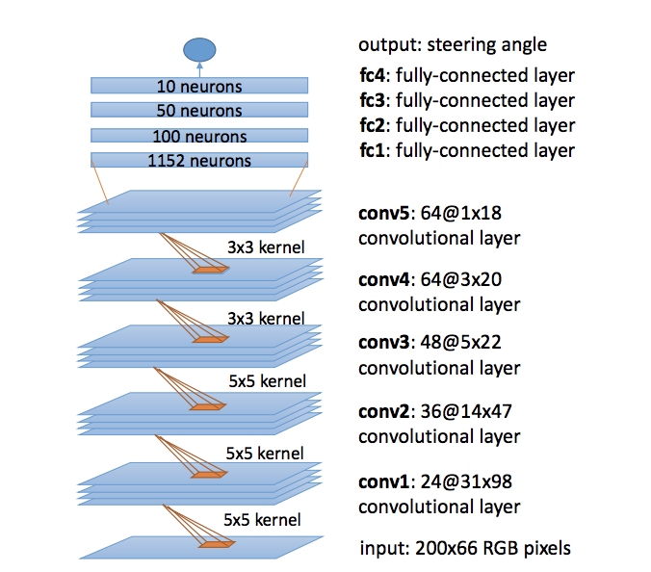
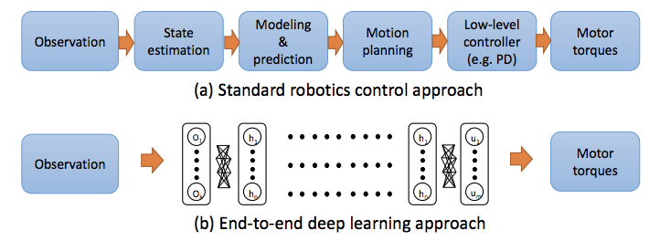
CNN (Dave-2) Design

Slide 6
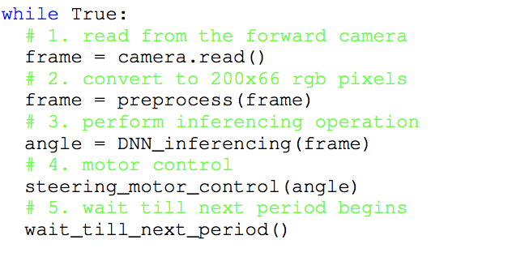
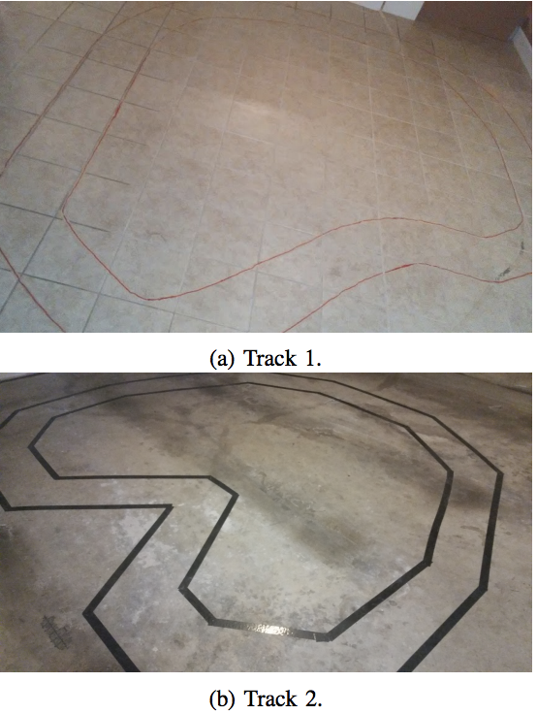
Control Loop
Test and Train Tracks

Slide 7

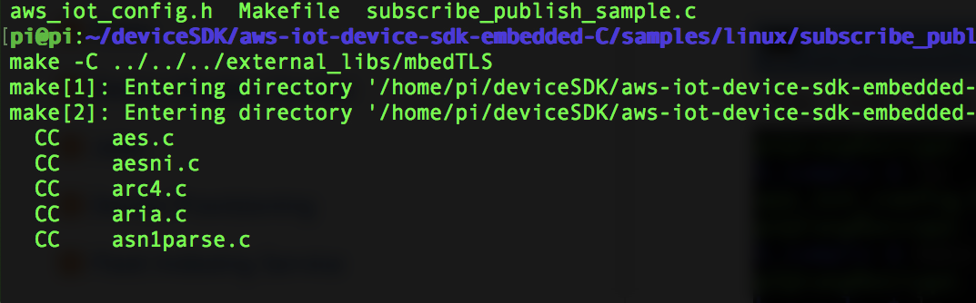
Next: AWS IoT Core + Device Management

